Slide 1
Housing Complaints
Task Force
26th October 2023

Slide 2
Agenda
Welcome & Introductions
Actions from Last Meeting
Q2 figures trends & preventative actions
Housing Ombudsman/Regulator update
TSM Q2 results
Preventative Actions for this quarter
Up Next…
AOB

Slide 3
Housing Repair Complaints Q2
Q1 – Received | BMBS | Asset Management | Asset Compliance | Total
2022/23 | 78 | 9 | 16 | 103
2023/24 | 81 | 4 | 48 | 133
% Change | 3.85% | -55.6% | 200% | 29.1%
Response Times
The average complaint response time in Q2 was 18.5 working days. This is up from an average of 16.9 working days in Q1.
We saw 60% of complaints responded to breach the 10-working day deadline, this is up from 45% in Q4.
Themes & Trends
Tenants are continuing to complain about the lack of progress towards repair works, often demonstrating that they have contacted the Councils on multiple occasions to get a repair scheduled. The Councils are still seeing high levels of complaints for compliance related matters which is a hangover from the contract with Aarons Services.
The Councils continue to receive complaints relating to damp and mould however, how this changes over winter and as Zap Carbon becomes more established remains to be seen. We are seeing complaints following Zap Carbon visits that work is not being carried out, could this be about the management of expectations with our tenants.

Slide 4
Tenancy Services & Housing Solutions Complaints Q2
Q1 – Received | Tenancy Management | Housing Solutions
2022/23 | 7 | 10
2023/24 | 14 | 11
% Change | 100% | 10%
Response Times
The average complaint response time in Q4 was 7.1 working days for Tenancy Services and 7.1 working days for Housing Solutions.
Neither Housing Solutions or Tenancy Management had any complaints breach the 10-day deadline that were responded to in Q2.
Themes & Trends
Tenancy Services saw complaints raised regarding the following:
Neighbour Disputes
Anti-Social Behaviour
Parking
1 of the 14 complaints were upheld.
Housing Solutions saw complaints regarding:
Social Housing Applications
Appeals to Gateway to Homechoice Banding
Only 1 of the 11 complaints received was partially upheld.

Slide 5
Stage Two Complaints & Housing Ombudsman Cases
Stage Two
Between 1st July and the 30th September 2023 the Councils’ received 14 stage two complaints regarding Housing Repairs, Asset Management and Asset Compliance. This is up 7 from 13 in Q2 last year.
Themes for this quarter include:
Tenants following up repairs reported and why they had not been scheduled
Escalation of complaints where no repairs had been undertaken that were detailed in stage one responses
Lack of communication regarding repairs
Housing Solutions received 2 stage two complaints and Tenancy Services received 3. Between the 5 complaints received, one was upheld.
Ombudsman Cases
The Councils have not had any Housing Ombudsman determinations or requests for evidence in this quarter.
The Councils are still waiting on the outcome of three investigations by the Housing Ombudsman.

Slide 6
Housing Ombudsman News
Islington Council ordered to pay £66k to residents
Poor record keeping and ‘consistent failure to communicate’
Islington Council was found to have a “disjointed” approach to complaints and “lack of clear ownership” that was leading to problems “drifting and persisting”.
Among the cases was a disabled resident unable to use their ground-floor wet room for months due to a lack of repairs. Another resident’s complaint was found to be stuck in the landlord’s system for three years.
The watchdog found teams that “appear to work in silos, rather than effectively with each other”, while “tension between objectives has caused inertia, with no overall ‘owner’ to make decisions”.
Residents may be “pushed between teams and misdirected, with no one taking ownership or managing progress toward a resolution”.
“poor record-keeping across the board is hampering an efficient and effective response”,

Slide 7
Islington Continued…
set up a Housing Improvement Board to raise standards and respond to new regulatory requirements. We will build on this and deliver the ombudsman’s recommendations through an expanded improvement plan.
a new, place-based approach to housing management” so residents have a single point of contact and “staff take ownership of their patch”.
There will be additional training for all repairs staff on customer service and learning from mistakes, trialling new approaches for damp and mould cases such as remote monitoring sensors, and a review of ASB services.

Slide 8
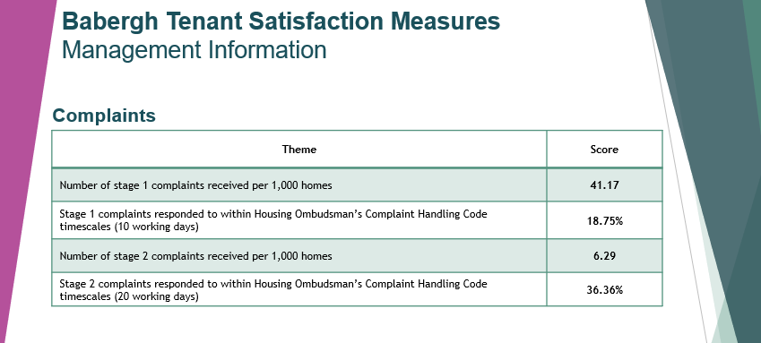

TSM Q1 & 2 Results for Complaints
23.52%

Slide 9
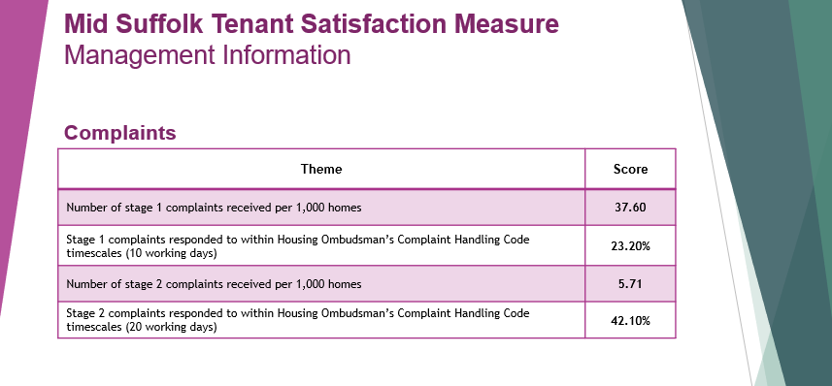

TSM Q1 & 2 Results for Complaints
30.76%

Slide 10

Over to you for Preventative Actions Identified this Quarter

Slide 11
Up Next…
CRM System being introduced for all of housing in January 2024
Introduction of Nigel Fox – Resolutions Coordinator
Ombudsman Session with Suffolk authorities
Getting through the backlog

