Slide 1
Housing Complaints
Task Force
26th July 2023

Slide 2
Agenda
Welcome & Introductions
Actions from Last Meeting – All/Kerry
Q1 figures trends & preventative actions – James
Housing Ombudsman/Regulator update – David
TSM Q1 results – David
Preventative Actions for this quarter
Up Next…
AOB

Slide 3
Housing Repair Complaints Q1
Q1 – Received | BMBS | Asset Management | Asset Compliance | Total
2022/23 | 88 | 11 | 16 | 115
2023/24 | 104 | 3 | 24 | 131
% Change | 18.19% | -72.7% | 50% | 13.91%
Response Times
The average complaint response time in Q1 was 16.9 working days. This was up from an average of 12.2 working days in Q4.
We saw 45% of complaints responded to breach the 10-working day deadline, this down from 59% in Q4.
Whilst more complaints are being responded to on time that in Q4, the ones that do breach are taking longer to resolve as demonstrated by the number of average working days.
Themes & Trends
The biggest theme and trend in our complaints from quarter one was that tenants were using the complaints system to chase up repairs or service requests that they had already reported, and this also linked into a lack of communication provided to our tenants. Jobs surrounding leaks, roofing, damp/mould and general repairs formed most of the complaints. There were also complaints where tenants were continuing to have problems with Aaron Services and getting boilers fixed in a suitable timeframe.

Slide 4
Tenancy Services & Housing Solutions Complaints Q1
Q1 – Received | Tenancy Management | Housing Solutions
2022/23 | 10 | 14
2023/24 | 14 | 18
% Change | 60% | 50%
Response Times
The average complaint response time in Q4 was 6.0 working days for Tenancy Services and 8.4 working days for Housing Solutions. Tenancy Services saw 25% of complaints breach their response deadline, whilst housing solutions breached on 1 of their 21 complaints recieved. This data is only for complaints responded to and not complaints that are still outstanding.
Themes & Trends
Tenancy Services saw complaints raised regarding the following:
Car parking and on road parking. One of these complaints highlighted the need for new signage.
There were two reports of abandonment
Rent payments
3 of the 14 complaints were upheld.
Housing Solutions saw complaints regarding:
Disabled Facilities Grants
Gateway to Homechoice
Homelessness Applications
Only 1 of the 18 complaints received was upheld.

Slide 5
Stage Two Complaints & Housing Ombudsman Cases
Stage Two
Between 1st April and the 30th June 2023 the Councils’ received 23 stage two complaints regarding Housing Repairs, Asset Management and Asset Compliance. This is up 10 from 13 in Q1 last year.
Themes for this quarter include:
Tenants following up repairs reported and why they had not been scheduled
Escalation of complaints where no repairs had been undertaken that were detailed in stage one responses
Lack of communication regarding repairs
Housing Solutions received 3 stage two complaints and Tenancy Services received two. Between the 5 complaints received, one was upheld, and one was partially upheld.
Ombudsman Cases
The Councils have provided information to the Housing Ombudsman for one investigation this previous quarter and there have been no decisions made by the Housing Ombudsman. We have had a decision towards the end of the previous quarter that will be discussed on the next slide.
Following the most recent Housing Ombudsman case that the Councils provided information for, there will be a new internal process and this will be covered in the upcoming complaints training. As a brief overview, after I have created the relevant documents and established the relevant contacts the information requests will be sent through to the Corporate Managers who will be responsible for the collation of information.

Slide 6
Housing Ombudsman Update
Ombudsman determination case – Update.
Improving Communication Action plan
Ombudsman News
Notes:
We had a determination from the ombudsman on a previous cases that they had investigated – due to delayed repairs that negatively impacted the family's day to day life.
The Housing Ombudsman have requested that the following actions take place, please can the following be arranged:
The Ombudsman orders that the landlord write to the resident to apologise for the service failures identified in this report.
The Ombudsman orders that the landlord pays the resident further compensation of £250 for the distress and time and trouble caused to her by the identified service failures in its complaint handling.
The Ombudsman orders that the landlord review its record keeping processes with particular regard to telephone and in-person resident communications, and provide an action plan of its intentions to make improvements within eight weeks of the date of this report.
The Ombudsman received 11,025 complaints and enquiries in the last quarter
Property condition continues to be the most complained about category at 68% of all complaints
In 64% of determinations, the Ombudsman found maladministration
The Ombudsman made 1,527 orders in the quarter.
The Housing Ombudsman has raised concerns with Lambeth Council after residents from a previously resolved case had the problems return, with the landlord once again not dealing with the issues satisfactorily and the Ombudsman finding maladministration.
This has led to the Ombudsman using paragraph 11 of the Housing Ombudsman Scheme to scrutinise evidence of complaints handling through an inspection of the landlord including through an in-person inspection of evidence. It is the first time these powers have been used.
The Ombudsman will evaluate evidence of the landlord’s complaint handling, including compliance with recent orders and recommendations and previous decisions relating to service improvements. It has engaged with both residents and the landlord on these cases and will establish how the landlord allowed the issues to resurface.
The poor complaint handling in these subsequent cases included not following its policies, failing to fully investigate the issues nor offering appropriate remedies. The Ombudsman would have expected to see more improvement in complaint handling following its special report in February 2022, especially as the landlord should have been aware of the issues in complaints previously investigated.
The Ombudsman is also due to hold an open meeting with residents of Lambeth Council, hosted by the landlord, in September to hear about the issues facing them and the landlord.

Slide 7
Action | Who | By When | Desired Outcome
Implement a CRM Module within our existing Housing Management System and provide access and training to all staff that interact with our customers | Housing Transformation Manager/Systems | Roll out between September – December 2023 | All customer contact is captured on the system and can easily be reported on, and we are able to clearly see the customer journey of any interactions.
Monitor usage of the new system and provide usage details to managers to ensure that all customer contact is being recorded and actioned. | All Housing Managers | December 2023 and ongoing | Where usage is not where we would expect, challenge and actions are put in place to address.
Implementation of a Council wide Data Programme Board with the workstreams of Data Culture, Data Governance, Data Centre of Excellence & Content Provision | ICT Corporate Manager and Programme Board Members | Ongoing | We will understand and manage our data consistently so that it supports our organisation, services and staff to make insight-driven, evidence-based decisions that support our corporate vision.
Housing IT Strategic Review | Housing Transformation Manager/Systems | Recommendations - July 2023 | A diagnostic on the current Housing IT landscape, taking into account the important facets of our organisation, processes, technology, information and customers (internal and external). We have a clear roadmap of our IT and System needs within the housing service.
Building Services Transformation - Process and Systems Excellence | Housing/Building Services Transformation | Recommendations July 2023 – Process and Systems Roll Out through to Dec 2023 | Further to recommendations within housing in line with the Housing Diagnostic a transformation of the process and systems in place with Building Services is also on-going.
Hold mandatory awareness sessions for all staff about the importance of recording and actioning customer communications. | Housing Transformation Manager & Customer Operations Manager | 3x Sessions planned in between September and October 2023 | Our people are supported to use the systems to capture customer contact more effectively
Data Quality and Management Review Audit | Housing Transformation Manager and ICT Corporate Manager | Recommendations by end of July 2023 | We will understand the gaps in our data quality and look to use the recommendations to make improvements.

Slide 8
Housing Ombudsman Process
James to review information requested and create master sheet and timeline document.
James will then send to relevant corporate managers/head of operations as well as CC’ing in Deborah and set an internal deadline of when information is required back. James will also set up meetings with CMs.
CM’s are now responsible for making sure information is collated before sending back to James. This will be done by completing a timeline of events, obtaining evidence and documents and answering the questions asked by the Housing Ombudsman
James to undertake a review alongside corporate managers on the internal deadline date.
Gary Allen and Samantha Lake to undertake final review prior to James sending off information to the Housing Ombudsman prior to their deadline.

Slide 9
TSM – Q1 Results
Satisfaction with complaint handling is around 27% satisfied - only those who made a complaint are asked (33 said yes out of 304 asked)
  Response Times
  Satisfaction with outcomes
  Promises not kept resulting in repeat call backs and stage 2s

Slide 10
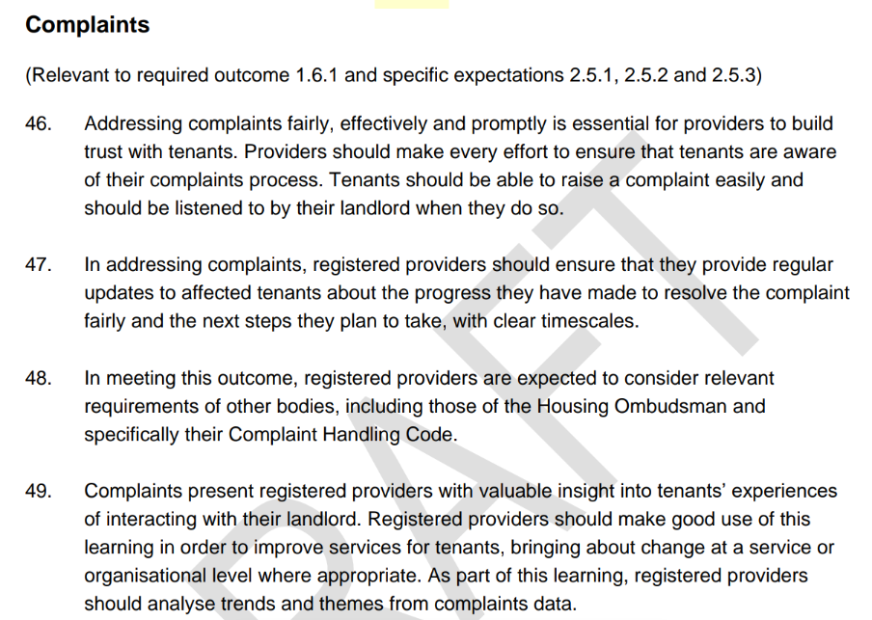
New Consumer Standards – Consultation

Slide 11

Over to you for Preventative Actions Identified this Quarter

Slide 12
Up Next…
Complaint Handling training booked in for August 2023
Update on PlaceCube – new digital platform and more informative reporting
Social Housing Stigma Awareness – comments coming through – Lunch and Learns for members and staff
Final complaint response audits have started.

