Slide 1
Housing Complaints
Task Force
17th January 2024

Slide 2
Agenda
Welcome & Introductions
Actions from Last Meeting –
Q3 figures trends & preventative actions
Housing Ombudsman/Regulator update
TSM Q3 results
Preventative Actions for this quarter
Up Next…
AOB

Slide 3
Actions from Previous Meeting
ACTION: Come back to the group with data around average zap carbon times and how we are keeping tenants in the loop around their damp and mould case.
At present, our referrals are as per the ‘Standard referral’s’ route. Any repairs noted are advised to the customer at the point of survey. Regarding the works arising from surveys, where works are issued to the DLO- yes, contact is then down to the DLO/ Scheduling team to arrange with the customer. With regards to works that require the quotation route, the customer is contacted by the contractor to arrange a visit to quote, and then the quote is passed to us. At present- we are having some delays due to the documentation supplied by contractors, but this should be resolved shortly. At present- we are having some delays due to the documentation supplied by contractors, but this should be resolved shortly. Call resident within 5 Working Days of receiving the job referral and book in job with the resident.
• Book in and complete the onsite HHPC assessment within 20 Working Days of receiving referral.
• Repairs to be uploaded to the ZapPortal within 7 working days of the visit.
• HHPC report to be sent to client within 28 Working Days of receiving the referral.
ACTION: Find out and get back to group about how previous contractor communicated with tenants and where the problems were
  Contractor allegedly repeatedly failed to respond to contact from customers, however this was our fault as well as we never proactively managed communications as part of the contract management.
ACTION: Discover if the new contractors do communicate to the tenants and what their process is?
In relation to Contractors, when they receive jobs through our interface, they contact our residents directly to arrange appointments. If any follow-on works are required, they email our compliance mailbox, and we will raise additional work orders/purchase orders to ensure these works are undertaken. Contractor will contact the resident again directly to arrange any further appointments. If there are any issues with no access, this all gets logged and after 3 no access tries it is escalated back to our compliance team where legal procedures will start.

Slide 4
Housing Repair Complaints Q3
Q1 – Received | BMBS | Asset Management | Asset Compliance | Total
2022/23 | 73 | 25 | 50 | 148
2023/24 | 129 | 2 | 64 | 195
% Change | +76.1% | -92% | +28% | +31.8%
Response Times
Building Services responded to 129 complaints in Q3, with 87 (67.4%) of these complaint responses breaching the 10-day deadline.
Asset Management responded to 3 complaints in Q3, with 3 (100%) of these complaint responses breaching the 10-day deadline.
Asset Compliance responded to 54 complaints in Q3, with 45 (83.3%) of these complaint responses breaching the 10-day deadline.
Themes & Trends
We are seeing a very high uphold rate of complaints, during Q3 the whole Housing Repair service upheld 168 (90.3%) complaints of the 186 complaints responded to.
We are continuing to uphold complaints for:
- A lack of communication
- Delays to repairs
Due to the time of year, we have also seen an increase of complaints regarding damp and mould, and a lack of preventative action. We have also had complaints regarding ZapCarbon which have been fed back to Richard Spencer and addressed in contractor meetings.

Slide 5
Tenancy Services & Housing Solutions Complaints Q4
Q1 – Received | Tenancy Management | Housing Solutions
2022/23 | 9 | 4
2023/24 | 21 | 6
% Change | 100% | 10%
Response Times
Tenancy Services responded to 19 complaints in Q3, with 2 of these complaint responses breaching the 10-day deadline.
Housing Solutions responded to 4 complaints in Q3, with 0 of these complaint responses breaching the 10-day deadline.
Themes & Trends
Tenancy Services:
- Upheld 3 of the 19 complaints responded to.
There were complaints regarding:
- No scheme manager on site
- Anti-Social Behaviour
- Rent Arrears/Charges
Housing Solutions:
- Upheld one of the 4 complaints responded to in Q3, where we could have actioned a phone call in a more appropriate manner.

Slide 6
Stage Two Complaints & Housing Ombudsman Cases
Stage Two
Between 1st October 2023 and the 31st December 2023 the Councils’ received 25 stage two complaints regarding Housing Repairs, Asset Management and Asset Compliance. This is up 108% from 12 in Q3 last year.
Themes for this quarter include:
- Delays to stage one responses
- Damp and Mould
- General delays to repairs at properties.
Housing Solutions received 0 stage two complaints and Tenancy Services received 4. Between the 4 complaints received, one was upheld which was regarding Anti-Social Behaviour.
Ombudsman Cases
The Councils have had one Housing Ombudsman case determined in the last quarter, this was regarding a complaint from a tenant that his storage heaters were not working correctly.
There are some lessons learned which will be talking about in a couple of slides.
The Councils are still waiting on the outcome of two investigations by the Housing Ombudsman.

Slide 7
Complaint Responses
We are not seeing enough firm details about appointments being booked for works required.
Too often we are saying ‘soon’, ‘as soon as possible’ – this then can result in repeat contact or stage 2 complaints.

Slide 8
Housing Ombudsman Determination Review
Background
Tenant Moved in in August 2022 via a mutual exchange.
First reported storage heating issues in November 2022.
Internal emails state “heating works, just very poorly”
Recommendation from contractor was to upgrade heating system to ASHP, then conflicting reports
Customer raised 4 more reports between November and January.
The resident raised a complaint on 13 February 2023. This was about the heating, as well as some broken fencing which the landlord promised to fix shortly after the tenancy started.
On 17 February 2023 it sent an internal email in respect of the request for an inspection. It said:
  a. It did not “currently have a budget” to upgrade the storage heaters.
  b. If it replaced one home’s heating, it would “open the floodgates” for other requests on the estate.
  c. It wanted to get “two separate reports that the heaters are working” so it could put the matter to bed.

Slide 9
Housing Ombudsman Determination Review
Assessment and Findings
Due to complaint being about excess cold – falls under HHSRS
Responses not fully recorded – no ‘whole property’ approach
We advised Heat pump not as economical as storage heating – calculation not accurate, based on incomplete data.
Concerned with our approach based on the language used in internal emails ‘open the ‘floodgates’ get 2 surveys done to ‘put this to bed’ focus was on if the heating worked as opposed to if they were fit for purpose, again concerning.
Report was anecdotal and not backed up by accompanied evidence
Medical condition mentioned and not taken into consideration – no record of alternative heating solutions.
Finding of maladministration

Slide 10
Housing Ombudsman Determination Review
Outcomes
Ordered to pay £300 in compensation for the distress and inconvenience caused by us failing to consider all reasonable options to resolve.
Instruct an independent surveyor to determine if storage heating is capable of heating the property to reasonable temperature.
If the property would be likely to meet a reasonable standard after the insulation works, the landlord must provide a temporary solution up to that point.
To be carried out in 4 weeks of the report.

Slide 11
Housing Ombudsman Determination Review
Lessons Learnt
Record keeping and approach
Not considering tenants medical needs
Sense check information before it being sent to the ombudsman – talked about how we calculate usage of heating and calculations.
Evidence gathered needs to have a reference point
Internal communication and language used when dealing with customers – concerning approach from the landlord.
Need to consider a whole house approach.

Slide 12
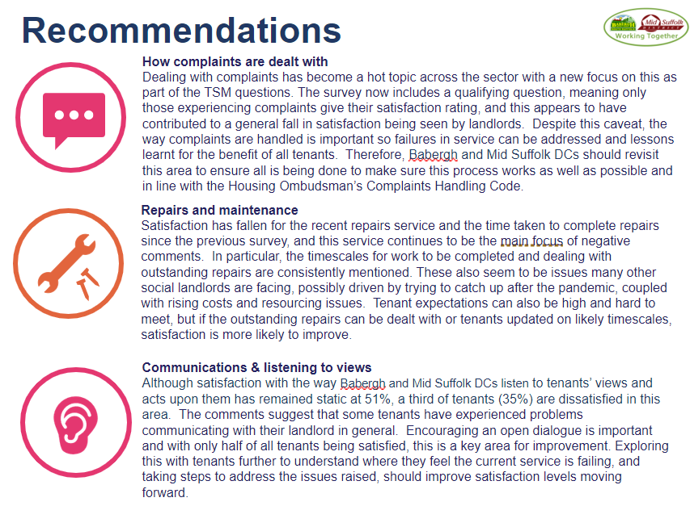
TSM Q3 Results for Complaint Handling

Slide 13

Over to you for Preventative Actions Identified this Quarter

Slide 14
Up Next…
Complaint Handling training – LGO (February/March)
New Complaints System (expected April) – better reporting.
Ombudsman Session with Ipswich – 1st March 2024
Complaints Improvement Day – 29th April 2024

